Slide 1
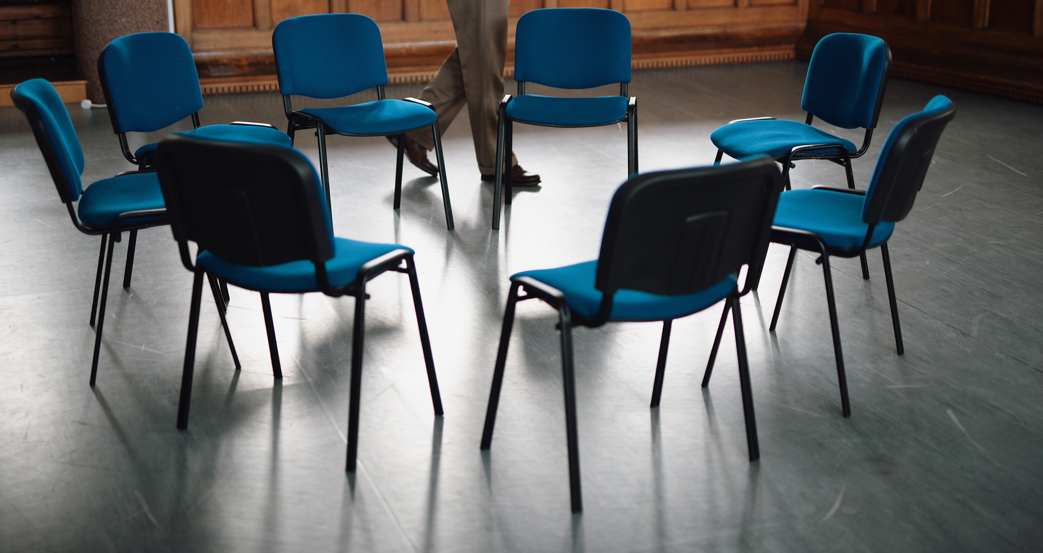
Team Building 1: Basics
Romans 12:4⎼5

Slide 2


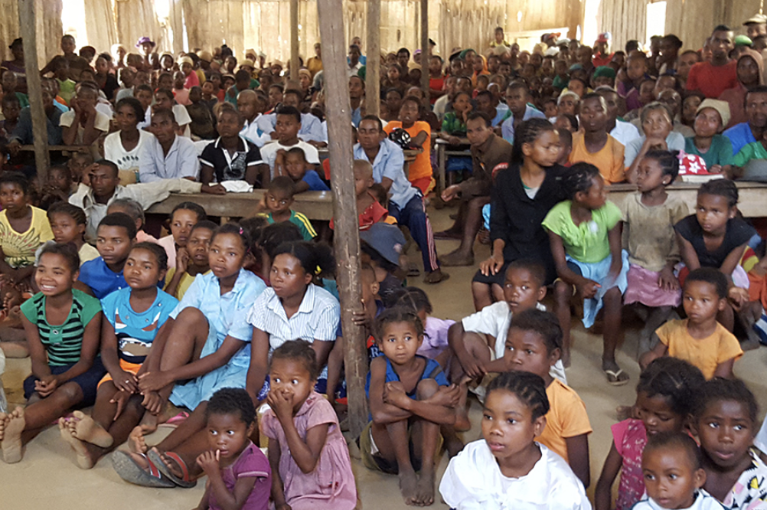




Hierarchy of Need (based on Maslow’s)
James 2:15 –16
Focus on Ministry
Esteem
Needs
Love and Belonging
Needs
Safety
Needs
Physical
Needs

Slide 3
Values-Based Learning
5 values

Slide 4

Honesty

Slide 5

Common Interest

Slide 6

Praise

Slide 7

Protection

Slide 8

Service

Slide 9
Honesty
Common Interest
Praise
Protection
Service
Ephesians 4:25
Philippians 2:1⎼2
1 Thessalonians 5:11
Acts 20:35
Matthew 20:26⎼28

Slide 10
?
How has feeling valued helped you?
How have you expressed value to others?

Slide 11
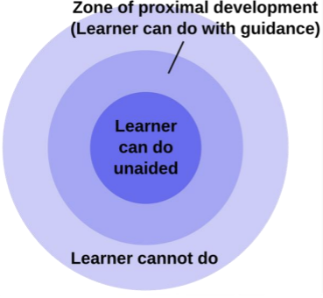
Zone of Proximal Development

Slide 12

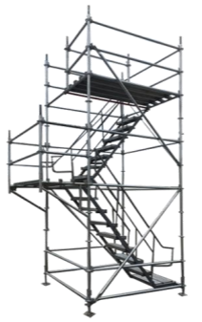


Scaffolding

Slide 13







Placing Translators in Groups
?
Acts
Mark

Slide 14


Personality Shapes
What’s Your Shape?

Slide 15


